Slide 1
Occupational hygiene
Alternative title slide
Indoor air
Ulla Lignell Ettas meeting
Kohtla-Järve 27.5.2011
Notes:
Alternative title slide. Image size: 7,97 cm x 25,4 cm or 301 x 960 pixels

Slide 2
Introducing Ulla Lignell
Ph.D. and M.Sc in Environmental sciences, Environmental health at Kuopio University
Ph.D. in 2008: ”Characterization of Microorganisms in Indoor Environments”
1998-2007 Indoor air researcher at National Public Health Institute (now National Institute for Health and Welfare), Department of Environmental Health in Kuopio
Authority guidance (Ministry of social affairs and health) concerning indoor air
2008-2009 Indoor air specialist at private company in Helsinki
2010 → Research Manager, occupational hygiene and indoor air at Ramboll Analytics

Slide 3
Image size: 7,94 cm x 25,4 cm
COMPANY PRESENTATION
RAMBOLL
Notes:
Alternative title slide. Image size: 7,94 cm x 25,4 cm

Slide 4
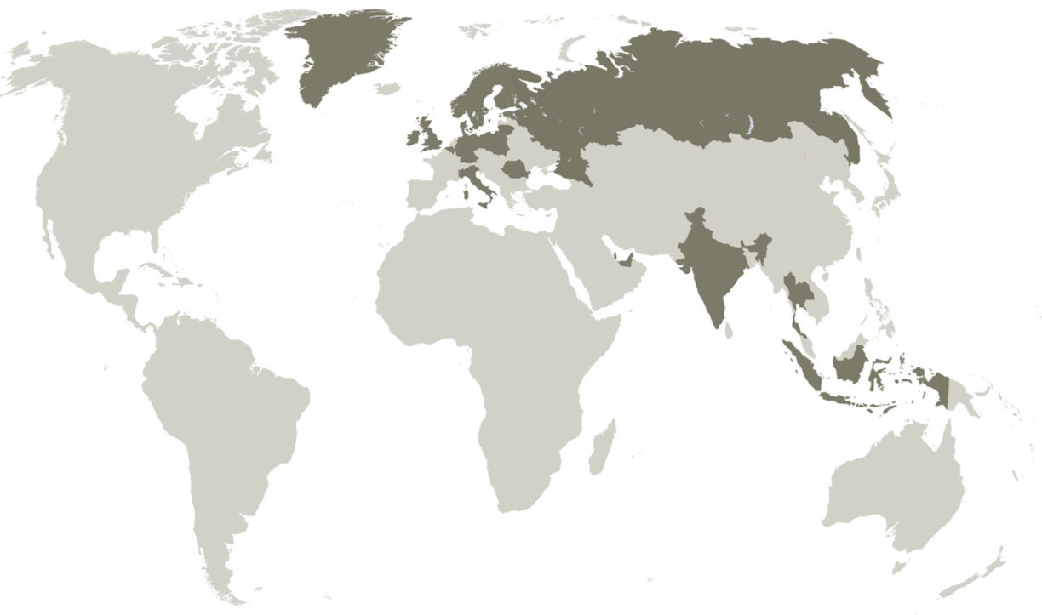
RAMBOLL GROUP
Founded in Denmark in 1945
Close to 10 000 specialists working in 23 countries
Main operating areas: Northern Europe, Russia, India and the Middle East
Turnover 6 MRD DKK(2010)
Notes:
Content slide, two columns with image. Image size: 11,29 cm x 10,79 cm

Slide 5
Image size: 7,94 cm x 25,4 cm
RAMBOLL IN ESTONIA
Ramboll Eesti, since 2006
A number of projects on multiple operation areas, strong cooperation with Ramboll Finland and Denmark
References:
Tallinna Airport, project management
Close-down planning for Kohtla-Järve and Kiviõli industrial waste disposal site
Highway Kose-Mäo, road planning
General planning for Länsi-Viro shipping lanes
Tarto eastern ring road planning

Slide 6
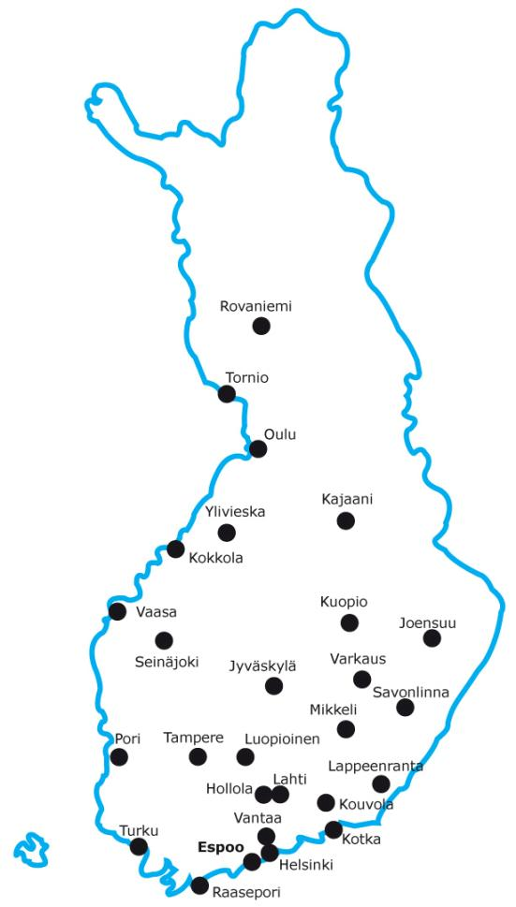
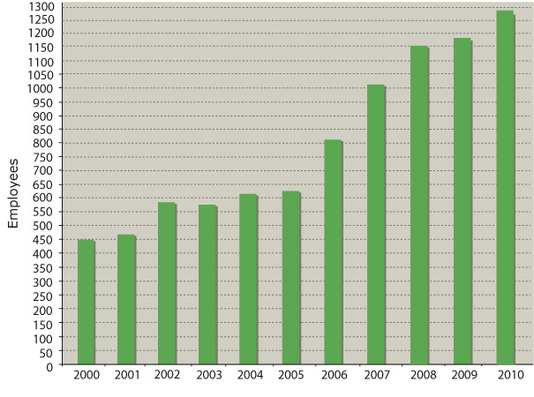
RAMBOLL FINLAND OY
Established in 1962
In 2010 about 1 300 employees in 27 regional offices
Turnover 89,8 M€ (2010)
Notes:
Content slide, two columns with image. Image size: 11,29 cm x 10,79 cm

Slide 7
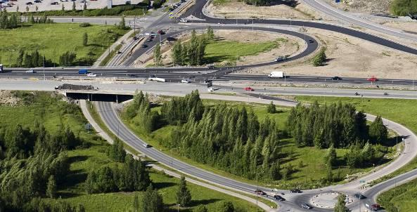
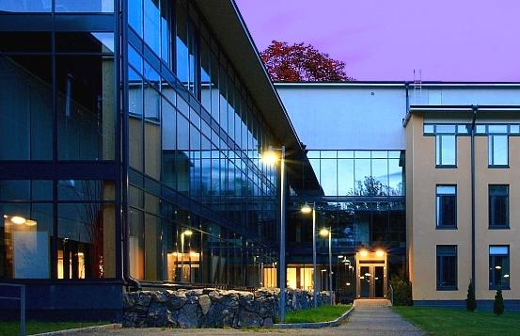
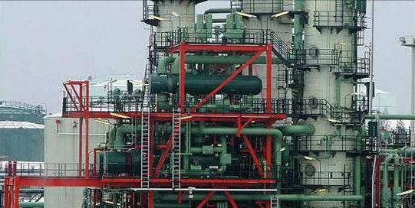
SERVICES
Infrastructure and Transport ▪ Water and Environment ▪ Buildings ▪ Industry and Energy ▪Management Consulting
Image size: 5,43 cm x 10,79 cm
Image size: 5,43 cm x 10,79 cm
Image size: 5,43 cm x 5,11 cm
Image size: 5,43 cm x 5,11 cm
Image size: 5,43 cm x 5,11 cm
Image size: 5,43 cm x 5,11 cm
Image size: 5,43 cm x 10,79 cm
Image size: 5,43 cm x 10,79 cm
Notes:
Content slide, two columns with 4 images.
Image size: 5,43 cm x 5,11 cm

Slide 8
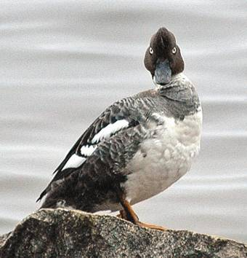
WATER AND ENVIRONMENT
App. 300 specialists in 11 regional offices
Acoustics and noise
Environmental Due Diligence
Air quality
Waste management
Laboratory and analyses
Landscape architecture and planning
Soil and ground water
Water supply
Water resources management
Environmental surveys
EIA
Image size: 11,29 cm x 10,79 cm
Notes:
Content slide, two columns with 4 images.
Image size: 5,43 cm x 5,11 cm

Slide 9
RAMBOLL ANALYTICS
Image size: 7,94 cm x 25,4 cm
The biggest environmental laboratory in Finland
A wide variety of inorganic, organic, microbiological and ecotoxicological analysing services
Emission and noise measurements
App. 100 specialists
App. 400 000 analyses / year
High level equipment
Notes:
Content slide, with top bar image. Image size: 7,94 cm x 25,4 cm

Slide 10
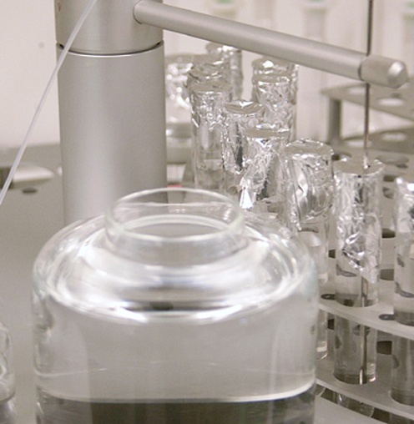
LABORATORy Services Ramboll analytics
Environmental laboratory
Industrial and power plant chemistry
Emission measurements
Field of expertise:
Microbiology, water chemistry, metals and elementary analyses, organic chemistry, chromatography, environmental consulting, indoor air, occupational hygiene
Contaminated soils, fuels, foods, materials, monitoring, research activities, waste material testing of acceptability for recycling and at landfills
Certified sampling
Accredited Testing laboratory (T039) by FINAS (Finnish Accreditation Service). Quality Management System is based on standards SFS-EN ISO/IEC 17025:2005 and ISO 9001:2000
Laboratory approval by EVIRA (Finnish Food Safety Authority Evira) for food and housing health analyses 5722/961/2006
Compliant with international Good Laboratory Practice Standard (FIMEA Finnish Medicines Agency)
Image size: 5,43 cm x 10,79 cm
Notes:
Slide with lime green fact box

Slide 11
Occupational hygiene
Title slide
Notes:
Title slide

Slide 12
Occupational hygiene measurements
According to Finnish legislation (Act on the Occupational Safety), the employer must be aware of the risk factors connected to work
If the employer does not have enough knowledge of the substances, third-party specialists can be utilised
Ministry of Social Affairs and Health, publication: ”HTP Values. Concentrations Known to be Harmful”
List of concentrations of impurities in workplace air known to be hazardous (TLV)
TLV: worker can be exposed day after day for a working lifetime without adverse health effects

Slide 13
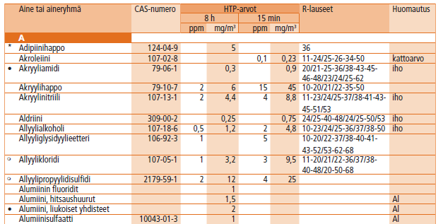
Occupational hygiene measurements
For workers’ occupational health and welfare purposes, the risk factors caused by work are important to explore and prevent

Slide 14
Occupational exposure
Noise
Chemical substances
Microbes
Dust
Vibration
Temperature conditions
Radiation
In Finland every year
Noise, vibration, radiation, cold: - 1,5 million workers
Chemicals:
- 1 million
Microbes:
- 200 000 – 300 000
Lime green fact box
Notes:
Slide with lime green factbox

Slide 15
Consequences of insufficient working conditions
Adverse health effects
Symptoms, absences due to illness, diseases
Most of the symptoms disappear when the exposure ends
Permanent effects, diseases such as asthma, cancer
Costs
To national economy in Finland 3 billion € per year
Of one occupational disease up to 1 million €
Of one day of illness up to thousands € (FIOH)

Slide 16
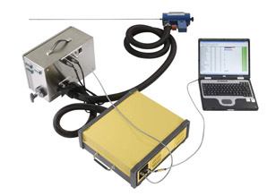
Sampling Methods in occupational hygiene measurements
Direct methods
Gas analysers
(e.g. FTIR Fourier transform infrared
spectroscopy)
Collecting methods
Actively by pumps
Many chemical substances
Dust
Passively by diffusion
Many solvents
Stationary and personal sampling
→ Methods are always chosen case-specifically

Slide 17
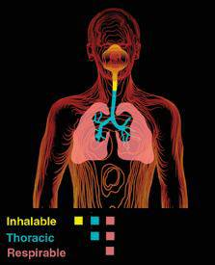
Particle Size-selective Dust Sampling
The American Conference of Governmental Industrial Hygienists ACGIH recommends that particle-size selective TLVs be expressed in three forms:
Inhalable Particulate Mass
Dust particles having a 50% cut-point of 100 µm. These dust particles are hazardous when deposited anywhere in the respiratory tract.
Thoracic Particulate Mass
Dust particles having a 50% cut-point of 10 µm. These dust particles are hazardous when deposited anywhere in the lung airways and gas-exchange regions.
Respirable Particulate Mass
Dust particles having a 50% cut-point of 4 µm. These dust particles are hazardous when deposited anywhere in the gas-exchange regions.

Slide 18
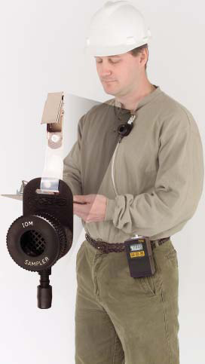
DUST measurements
IOM-sampler
Inhalable particulate mass (up to 100 µm)
Simulates the manner in which airborne workplace particles are inhaled through the nose and mouth
Sampling time 1 – 8 h
Gravimetric weighing
HTP-values:
Organic dust
8 h 5 mg/m³, 15 min 10 mg/m³
Inorganic dust
8 h 10 mg/m³

Slide 19
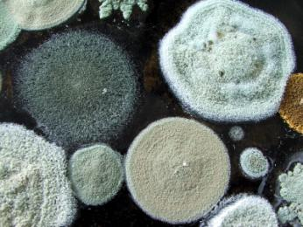
Occupational exposure to microbes
Concentrations of viable microbes and endotoxin
Fungi (molds and yeasts), bacteria (incl. actinomycetes and gram – bacteria)
No occupational TLV:s
Suggested in the Netherlands: viable microbes 10 000 cfu/m³
International suggestion for endotoxins: 90 EU/m³
Difficult or impossible to pose TLV:s based on adverse health effects
Different kinds of microbes with different characters
Individual differences
Often excessive exposure at biowaste treatment plants
Concentrations of viable microbes easily 10⁵ cfu/m³

Slide 20
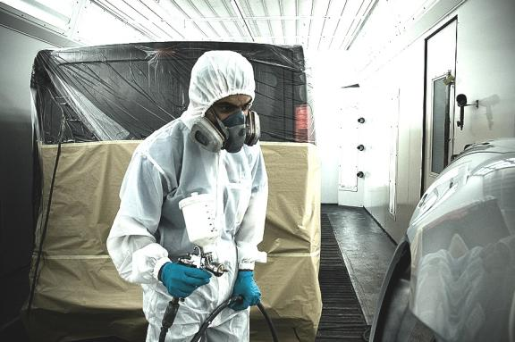
Ramboll Services in occupational hygiene
Planning of accurate investigations
Measurements
Laboratory analyses
Risk assessment, evaluation of exposure, comparing to HTP-values
Recommendations to minimize adverse health effects, follow-up
Information meetings to employees

Slide 21
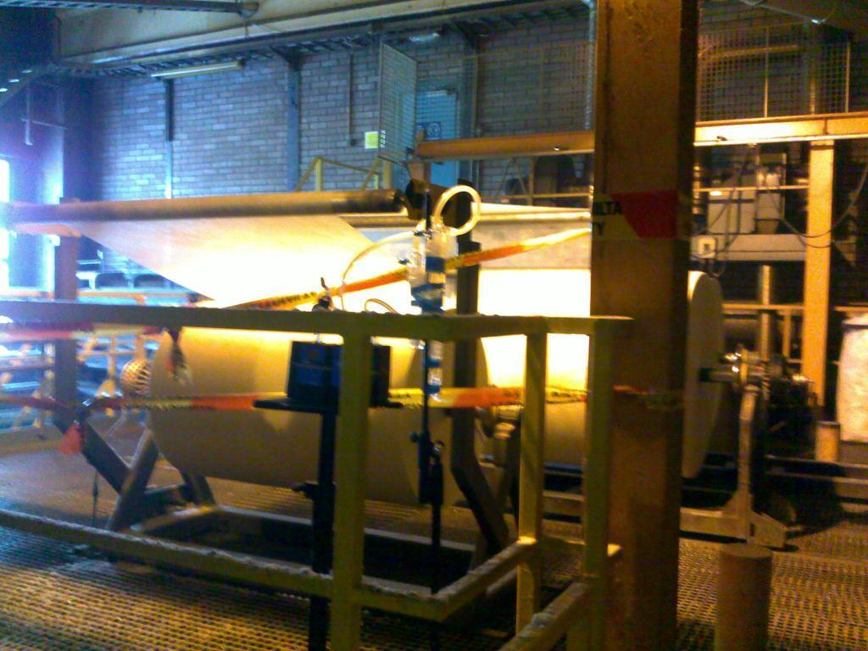
Examples
Glass fibre factory- ammonia, formaldehyde,
inhalable dust, phenol

Slide 22
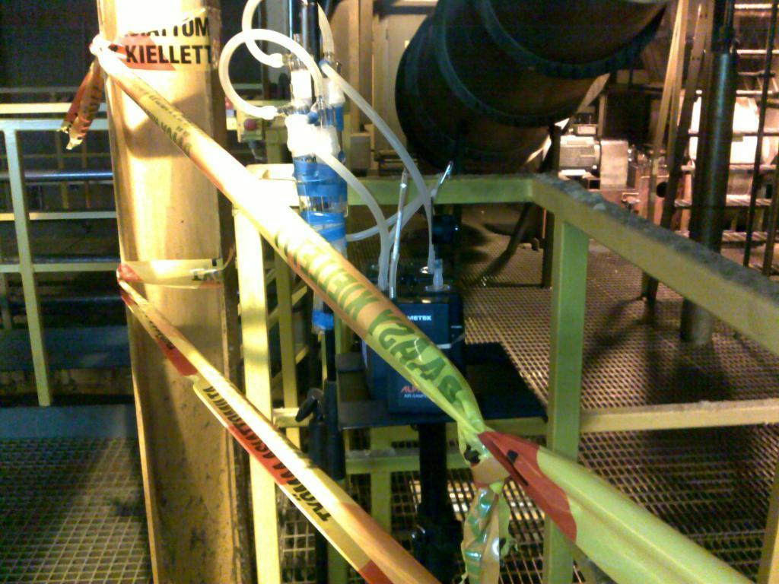
Glass fibre factory- ammonia, formaldehyde,
inhalable dust, phenol

Slide 23
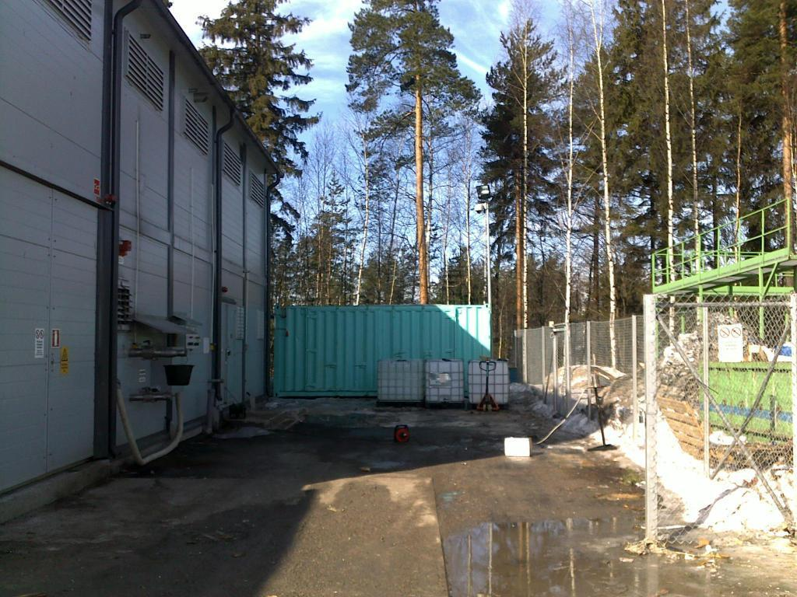
Biowaste as raw material using plant
- microbes, endotoxins, dust, noise

Slide 24
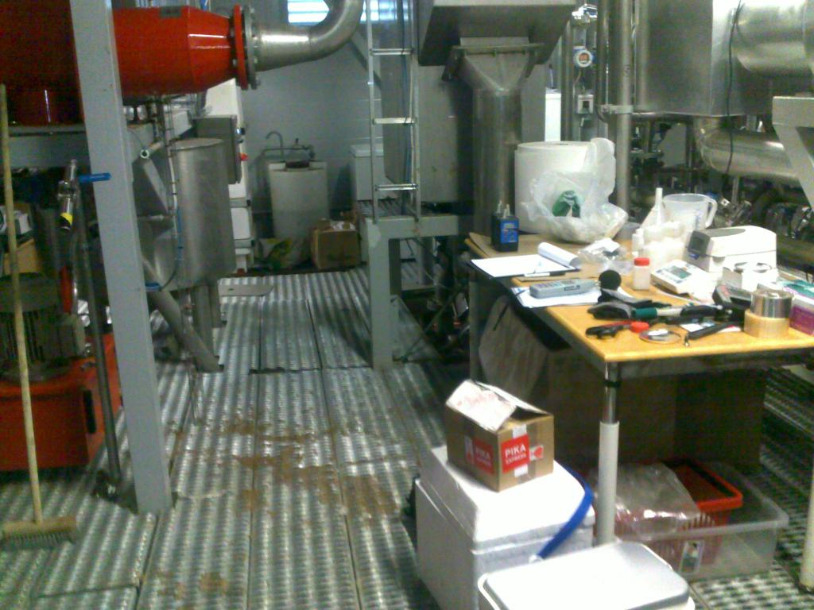
Biowaste as raw material using plant
- microbes, endotoxins, dust, noise

Slide 25
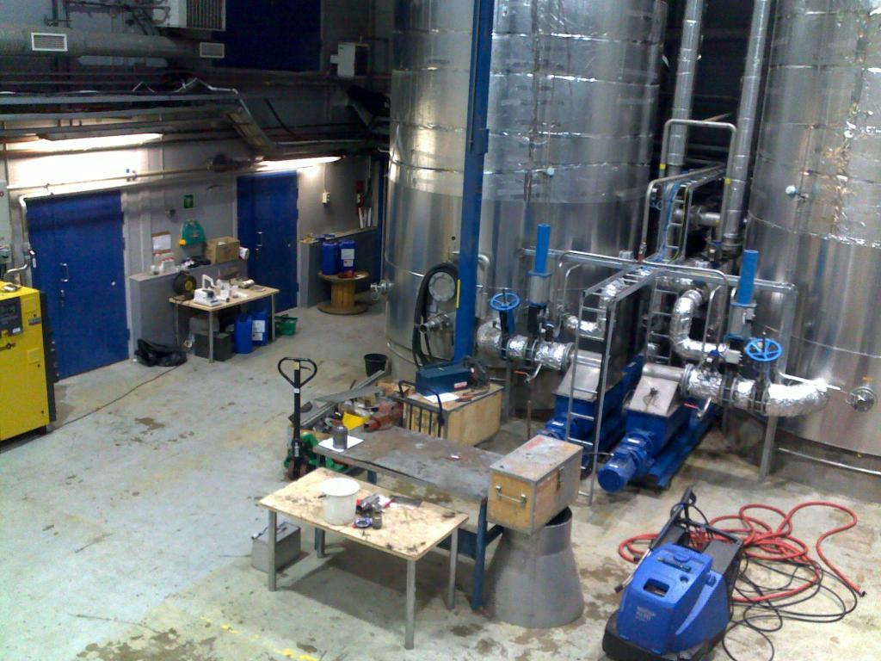
Biowaste as raw material using plant
- microbes, endotoxins, dust, noise

Slide 26
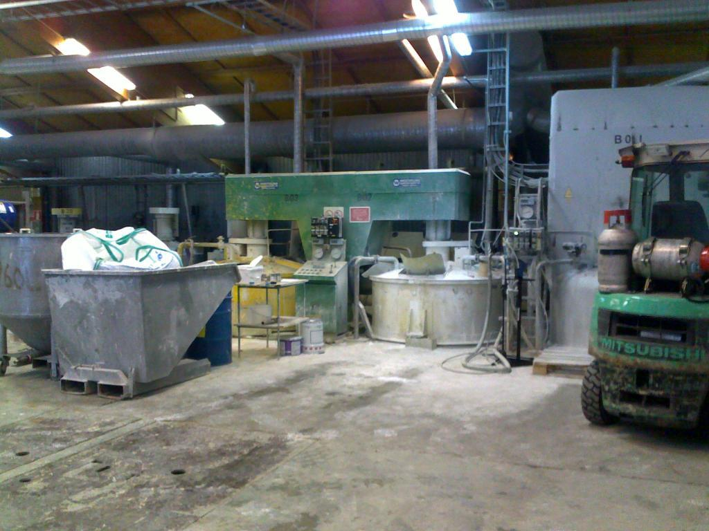
Paint factory- dust, ammonia

Slide 27
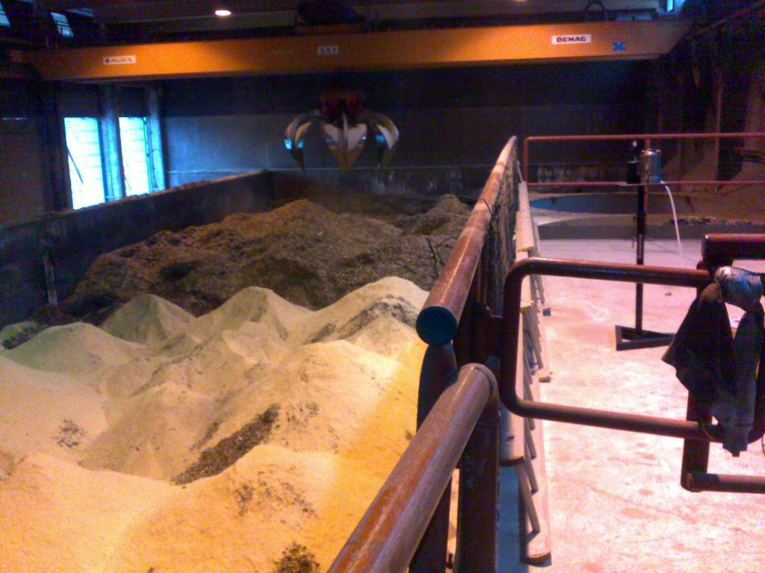
Heat and power plant, wood chips- dust, microbes, endotoxins

Slide 28
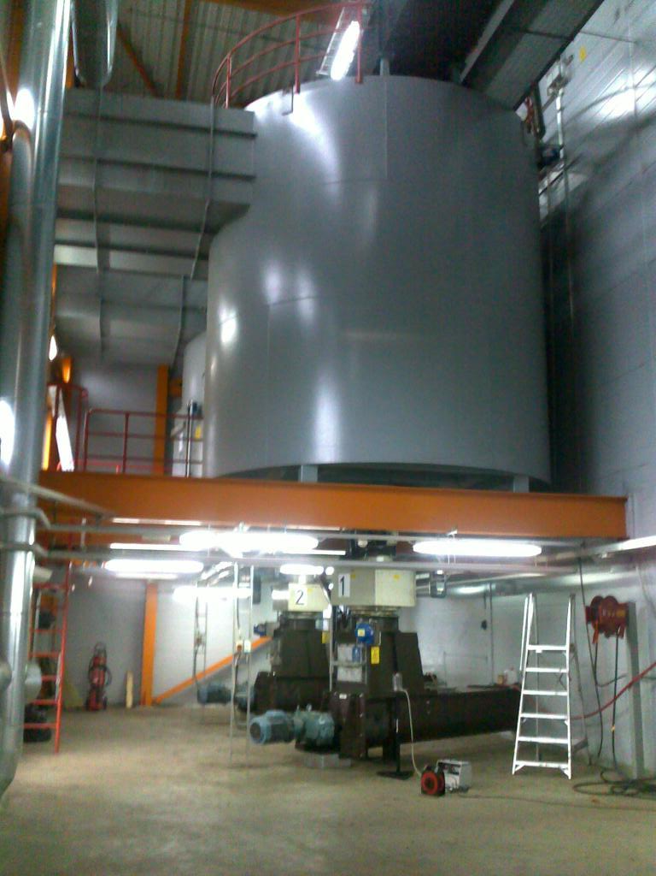
Heat and power plant, wood chips
- dust, microbes, endotoxins

Slide 29
Indoor air

Slide 30
Indoor air investigations
Multi-professional expertise
Microbes, VOCs and other chemical compounds, particles, mineral fibres
Ventilation, physical factors
Construction technology
Moisture content investigations, repairing of moisture damage
Risk structures
Sealing of constructions
Selection of materials
Health care
GOOD INDOOR ENVIRONMENT
Indoor Air Quality (IAQ) and general cleanliness ok
Users of facilities are satisfied
Appropriate procedures in problem situations
Lime green fact box
Notes:
Slide with lime green factbox

Slide 31
Indoor air problems vs. symptoms
Moisture damage and mold problems are strongly associated with adverse health outcomes
Asthma, allergy, sick building syndrome (SBS), respiratory infections, irritation in respiratory system, eyes and skin, non-specific symptoms like fatigue, headache
Symptoms may be due to several other reasons, such as poor ventilation and chemical compounds
Individual differences
SOLVING IS
CHALLENGING!

Slide 32
Generality of moisture damage
All over the world
In Finland
Signs of moisture problems 70 % of day care centers, 55 % of homes, 53 % of schools
600 000 – 800 000 are exposed to mold
Costs of mold problems to health care system app. 200 million € per year
Costs of insufficient IAQ app. 3 billion € per year ~ heating costs of the whole Finnish building stock per year
→ Government: programme called ”Work party for moisture and mold problems” for years 2010-2014

Slide 33
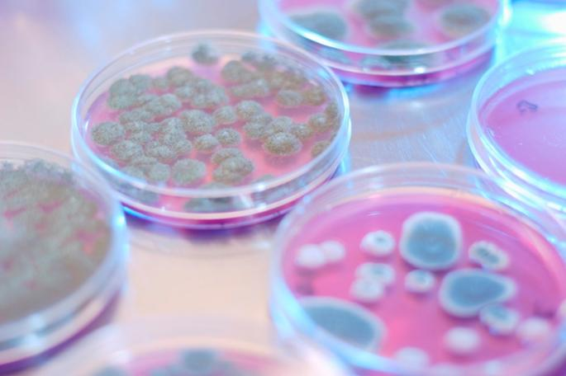
Guideline values
Not based on health outcomes!
Guidelines for
housing (Ministry of Social Affairs and Health)
schools (National Public Health Institute)
offices (Finnish Institute of Occupational Health)

Slide 34
Ramboll services in iAQ
All-inclusive services
Solving indoor air problems
Measurements of impurities, technical investigations including moisture content measurements and survey of risk structures, ventilation
Recommendations for repair
Planning of renovation
Supervision of renovation work
Follow-up
Health questionnaires before / after

Slide 35
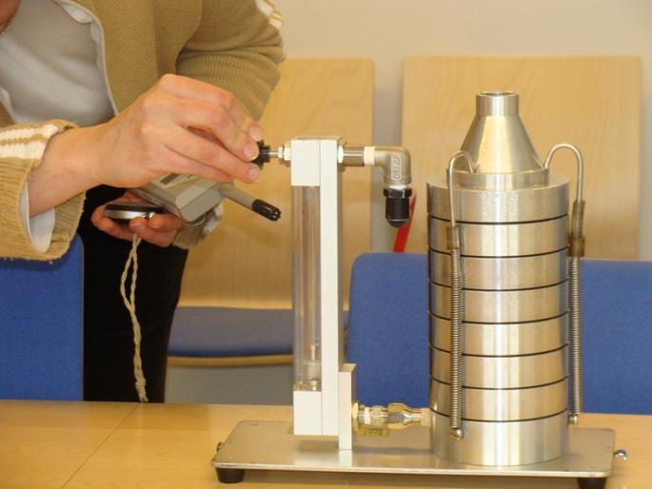
Moisture damage and microbes
Primary factor controlling microbial growth (fungi, bacteria, actinomycetes) is the availibility of water
Methods of investigation
Material and surface samples
Culturing straight to media
Analysing by dilution method*
Air samples
Andersen-impactor *
→ Air samples are used when the damage is not clear, but symptoms refer to possible moisture damage
*FINAS accredited

Slide 36
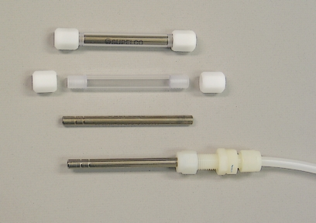
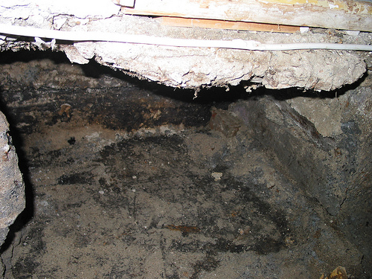
Indoor air measurements, Chemical compounds
Volatile organic compounds
Building materials, furniture, chemicals, cleaning agents, microbial growth
PAH-compounds
Creosote containing PAHs is used in old buildings as waterproof material
Carcinogenic

Slide 37
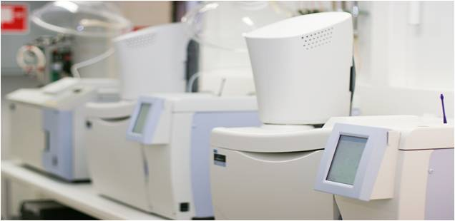
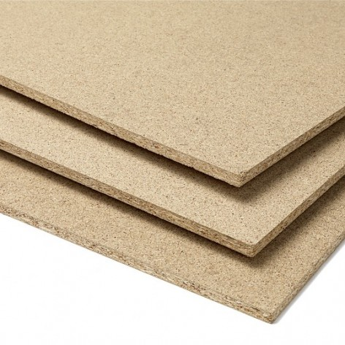
Indoor air measurements, Chemical compounds
Ammonia
Building materials, cleaning agents
Moistened materials as outcome from decomposing processes
Formaldehyde
Building materials containing adhesives with formaldehyde
Chipboards especially during renovation work
Laminates, parquets, panelworks
Varnishes, paints, textiles

Slide 38
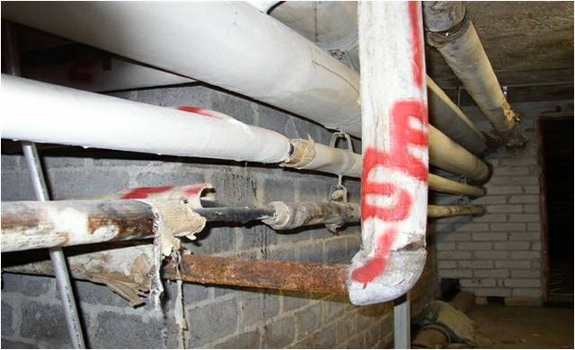
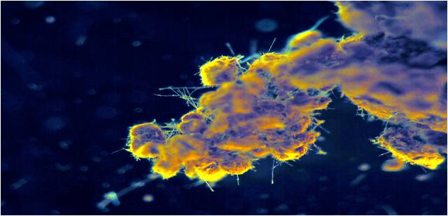
Building materials –asbestos, PCB and lead
Asbestos:
Demolition work of old buildings may release harmful asbestos fibres
PCB-compounds and lead:
PCB and asbestos are used in joint compounds until 1970s
Paints, adhesives, varnishes may contain PCBs

Slide 39
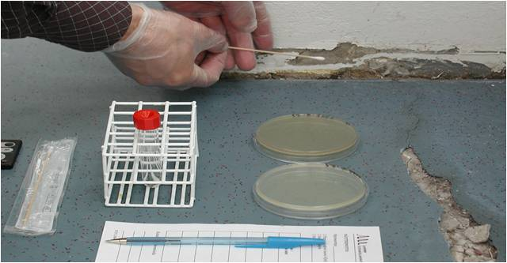
Sampling
Needs expert knowledge

Slide 40
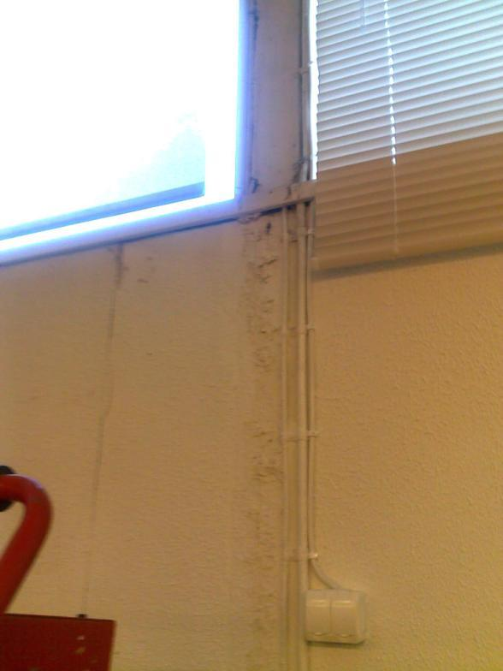
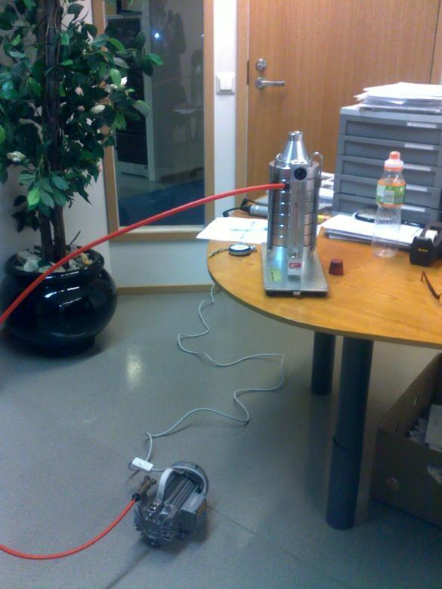
Examples
Offices

Slide 41
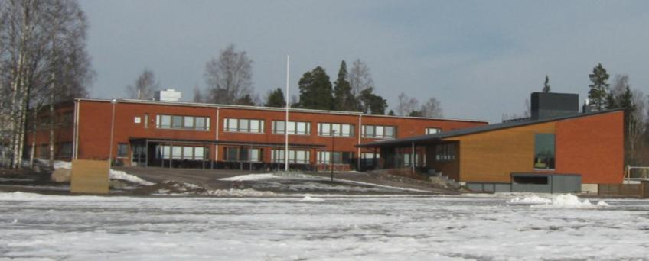
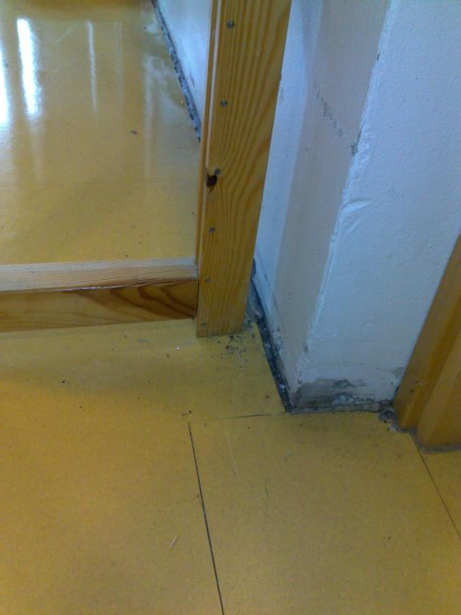
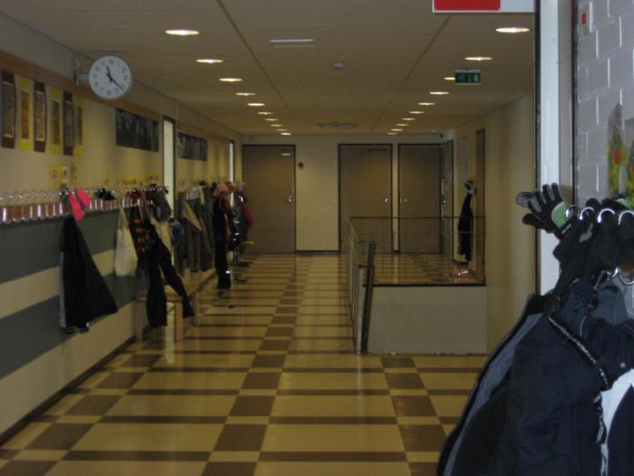
Schools

Slide 42
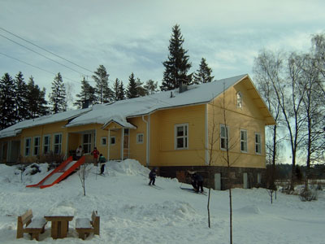
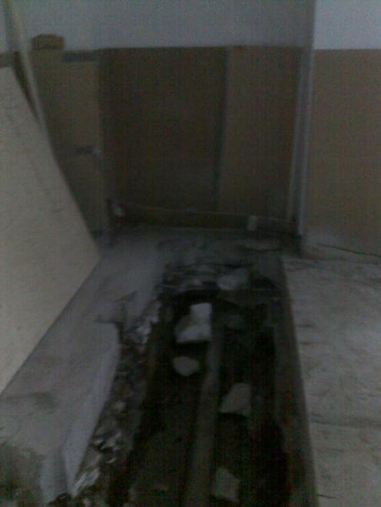
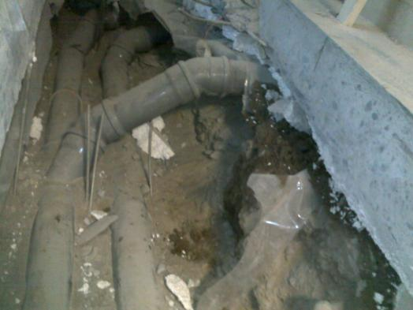
Day care centers

Slide 43
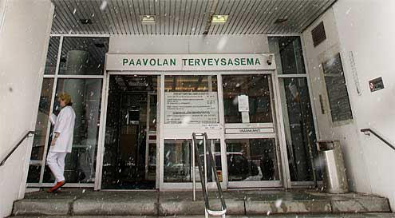
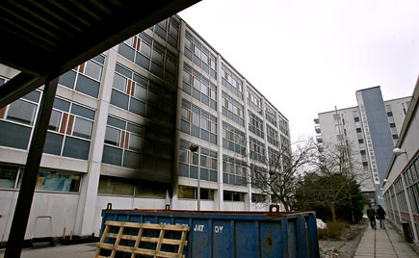
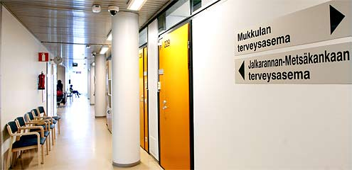
Health center

Slide 44
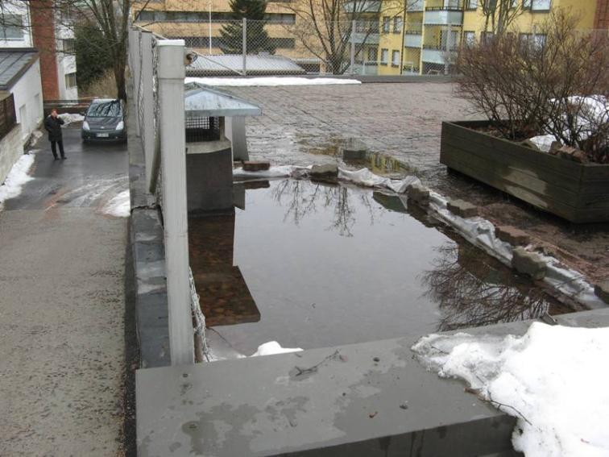
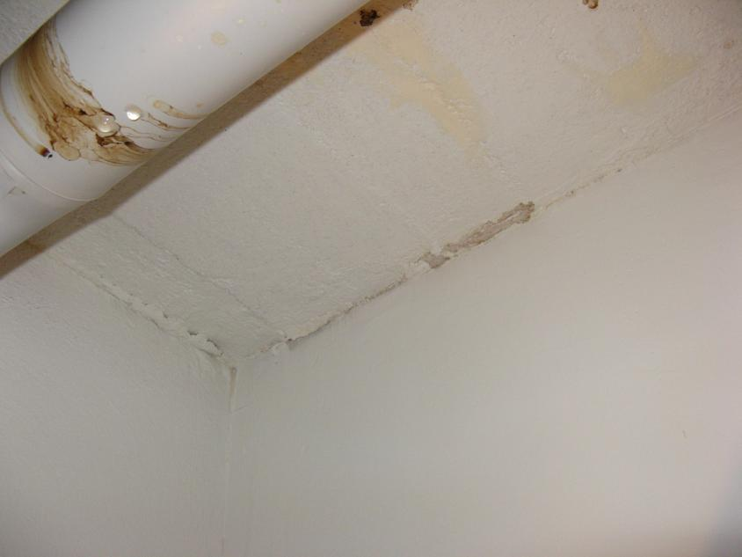
From storeroom to apartment?

Slide 45
Thank you
Endslide.
Notes:
Endslide

